Slide 1
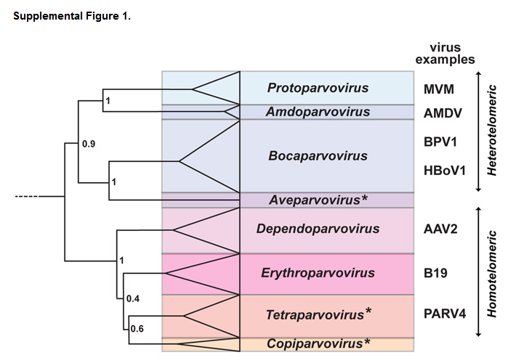
Cotmore, Tattersall. Parvoviruses: Small does not mean simple. S1

Slide 2
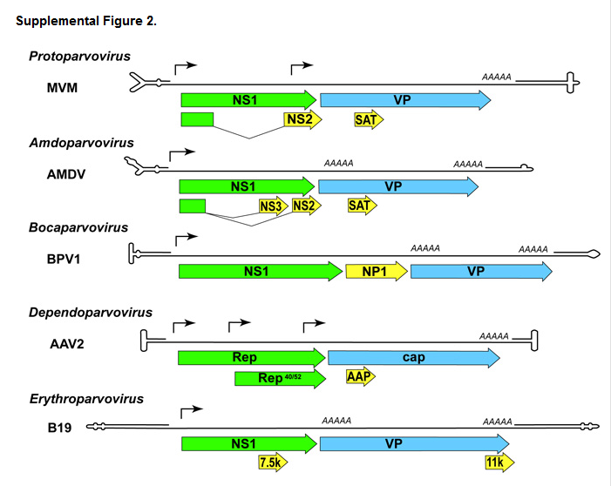
Cotmore, Tattersall. Parvoviruses: Small does not mean simple. S2

Slide 3
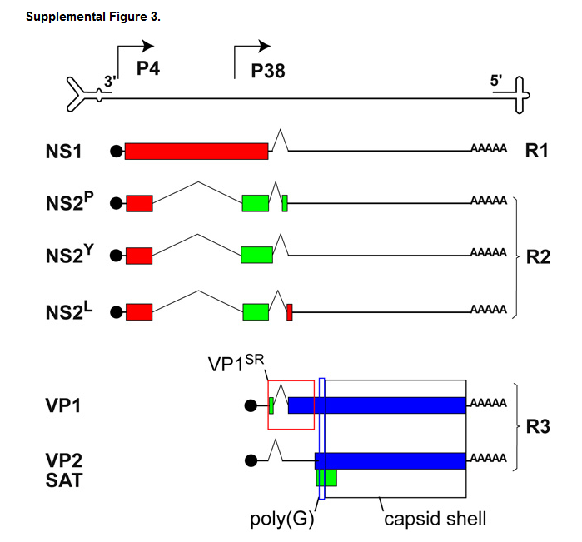
Notes:
Transcription and coding profile of minute virus of mice (MVM). The viral genome is indicated by a single line terminating in disparate hairpin telomeres (scaled at ~20× relative to the rest of the genome). Below this, line diagrams represent individual transcripts. Coding sequences are indicated in these mRNAs by boxes, which are color coded to indicate which of the three reading frames (ref… astell cr, gardiner em, tattersall p, 1986) they employ. Transcriptional promoters are positioned at map units 4 and 38 (P4, P38). P4 is the first promoter to fire during infection and drives the synthesis of transcripts R1 and R2, which are polyadenylated (AAAAA) near the right end of the genome. These encode NS1 and three C-terminally distinct forms of NS2 (NS2^{P}, NS2^{Y}, and NS2^{L}). NS1 then binds upstream of the P38 promoter and drives synthesis of R3 transcripts that are alternatively spliced to encode either VP1 or VP2 and SAT. N-terminal protein sequences boxed in red, denoted VP1^{SR} (VP1-specific region), are unique to VP1. Sequences boxed in black, comprising the C-terminal region common to all VP polypeptides, assemble to form the capsid shell; poly(G), boxed in yellow, identifies a short glycine-rich peptide sequence present in all VPs that can be modeled into X-ray density occupying capsid fivefold pores in DNA-containing virions.
Figure 1-1. Genome architecture of the parvovirus genus. The single‐stranded, negative‐sense DNA genome of the parvovirus genome with the terminal folded hairpin structures is shown. The two viral promoters, P4 and P38 are shown by rightward arrows, and the mature, cytoplasmic transcripts R1, R2, and R3 are displayed below, with a blue sphere indicating the capped 5′ ends and AAA denoting their polyadenylated tails. ORFs specifying the viral gene products, named on the right, are displayed in different shades according to their reading phase, and their spliced‐out introns are represented by the thin‐lined carets. The dashed box denotes the VP1u region involved in entry functions.

Slide 4
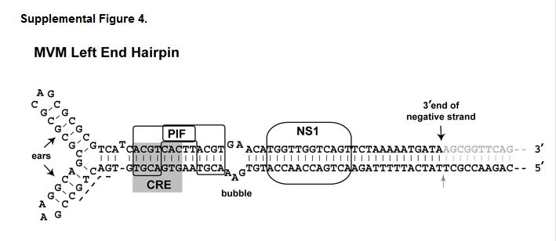
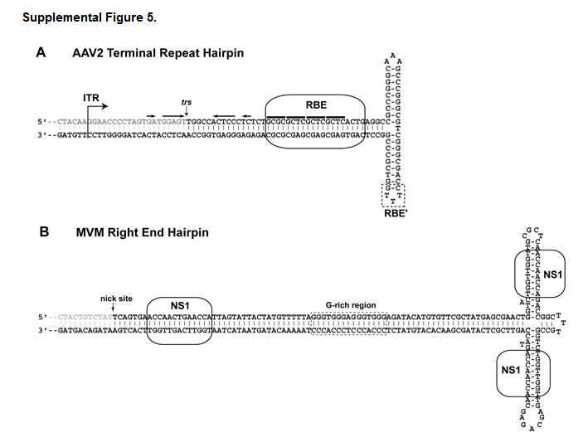

Slide 5
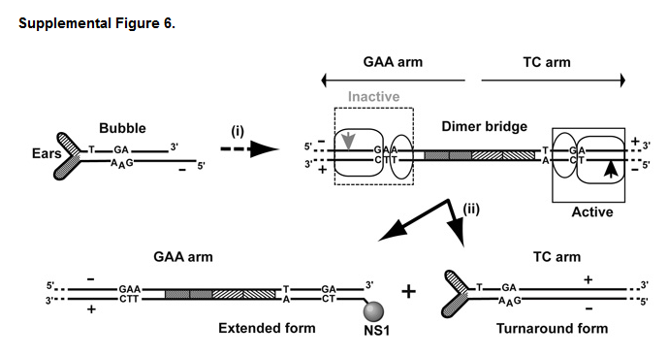

Slide 6
